Slide 3
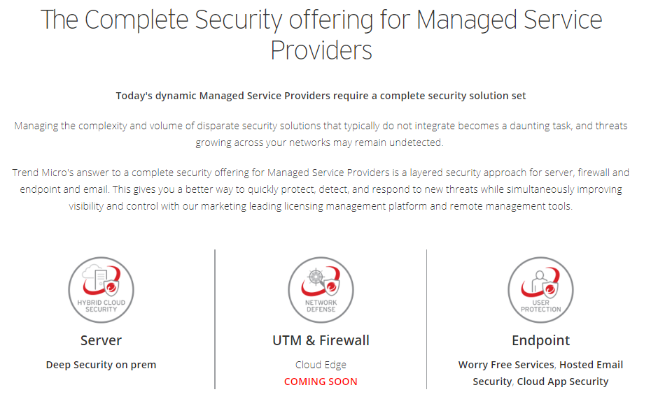

Slide 4
Introducing Trend Micro Cloud Edge
Trend Micro Cloud Edge
UTM solution for small business focused MSPs
Purpose-built for Managed Service Providers (MSPs)
Better performance
Superior management

Slide 5
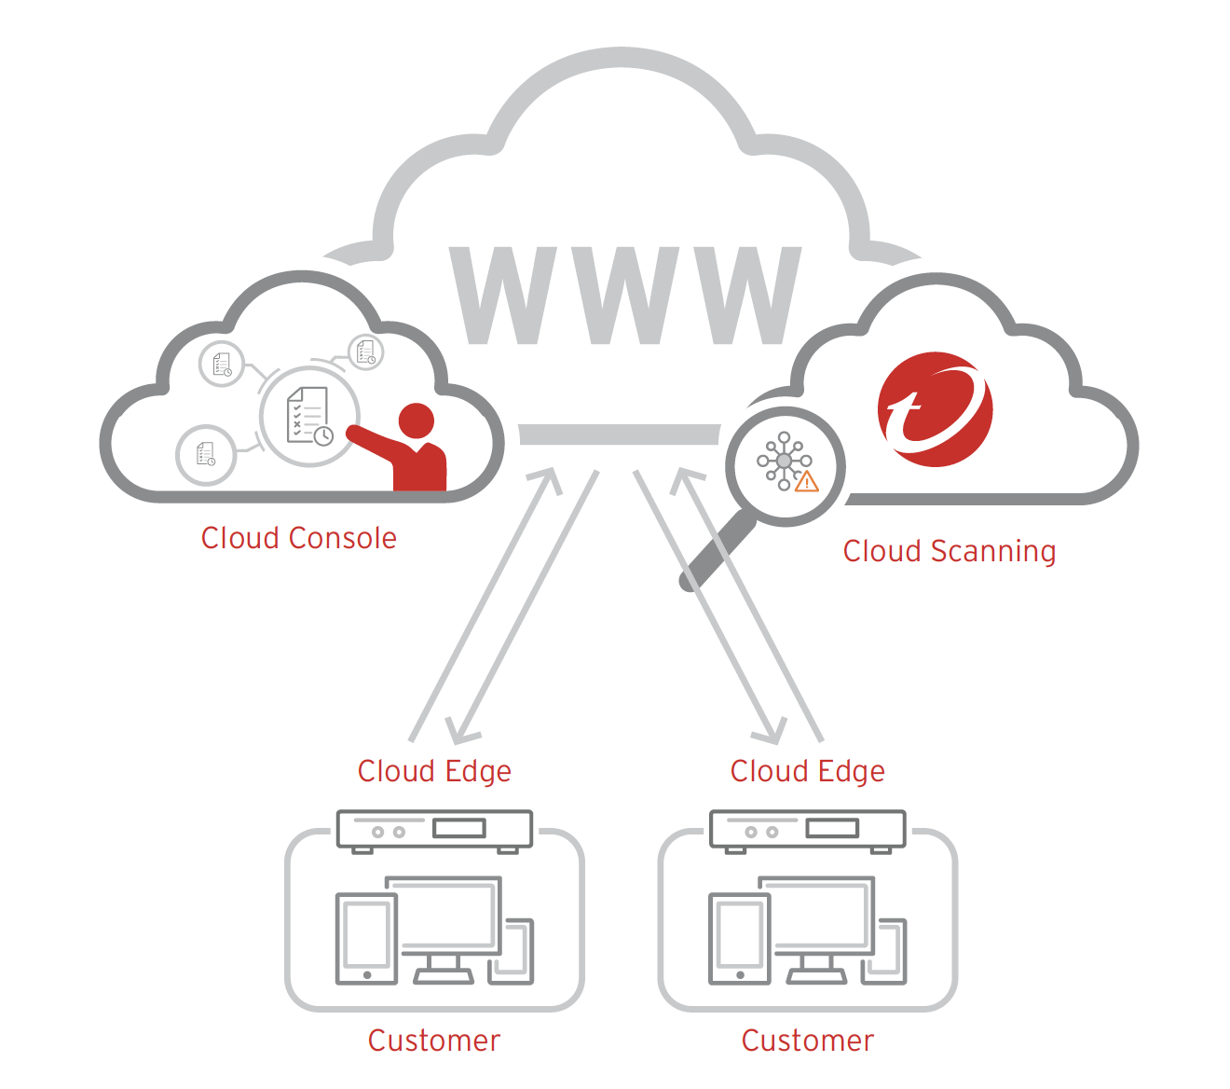
Cloud Edge Components
1
2
Cloud Sandbox
Machine Learning
Malware Scanning
Web Reputation
Email Scanning
Management
Logs & Reports
APIs
Firewall
App Control
Dual-WAN
URL Filtering VPN
QoS
HTTPS (SSL Scanning)
Anti-DOS (DDOS)
IPS
3

Slide 6
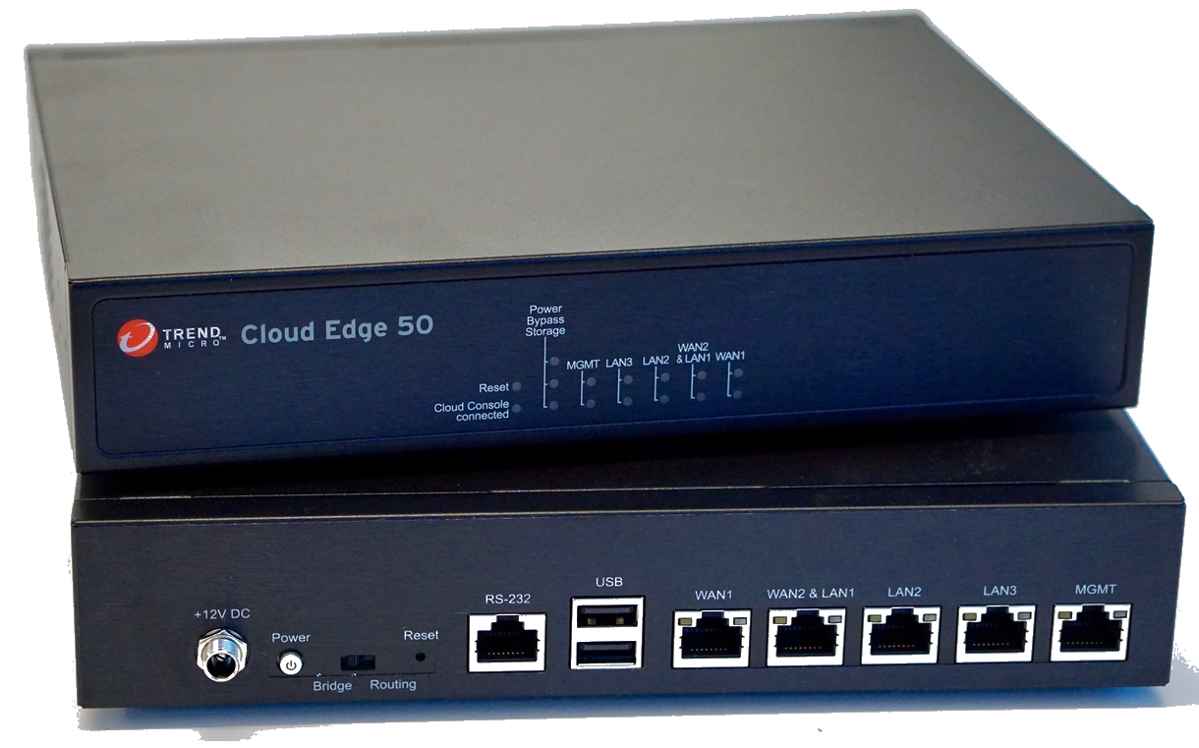
Trend Micro Cloud Edge

Slide 7
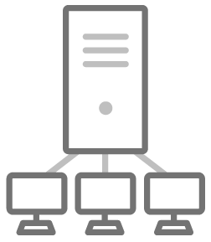
Manage Service Provider Requirements
Purpose Built for MSPs
MSP Pricing Model
Integrates with existing tools
Better Performance
Maximum Security
Minimal user impact
Superior Management
Native SaaS
Fewer consoles

Slide 8
MSP Friendly
Program Feature | Trend Micro | Competitor A | Competitor B
Monthly PAYG | ✅ | ✅ | ✅
Simple pricing model (1 SKU, 1 Price) | ✅ | ❌ | ❌
No term commitment | ✅ | ❌ | ✅
Automated billing | ✅ | ❌ | ❌
Single console (Endpoint + Email + UTM) | ✅ | ❌ | ❌
*
* One single upfront payment

Slide 9
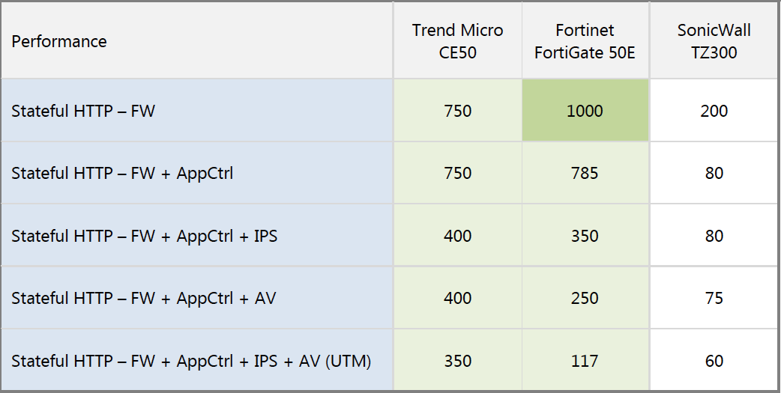
Better Performance
6X
3X
Miercom Competitive UTM Assessment – May 2019

Slide 10
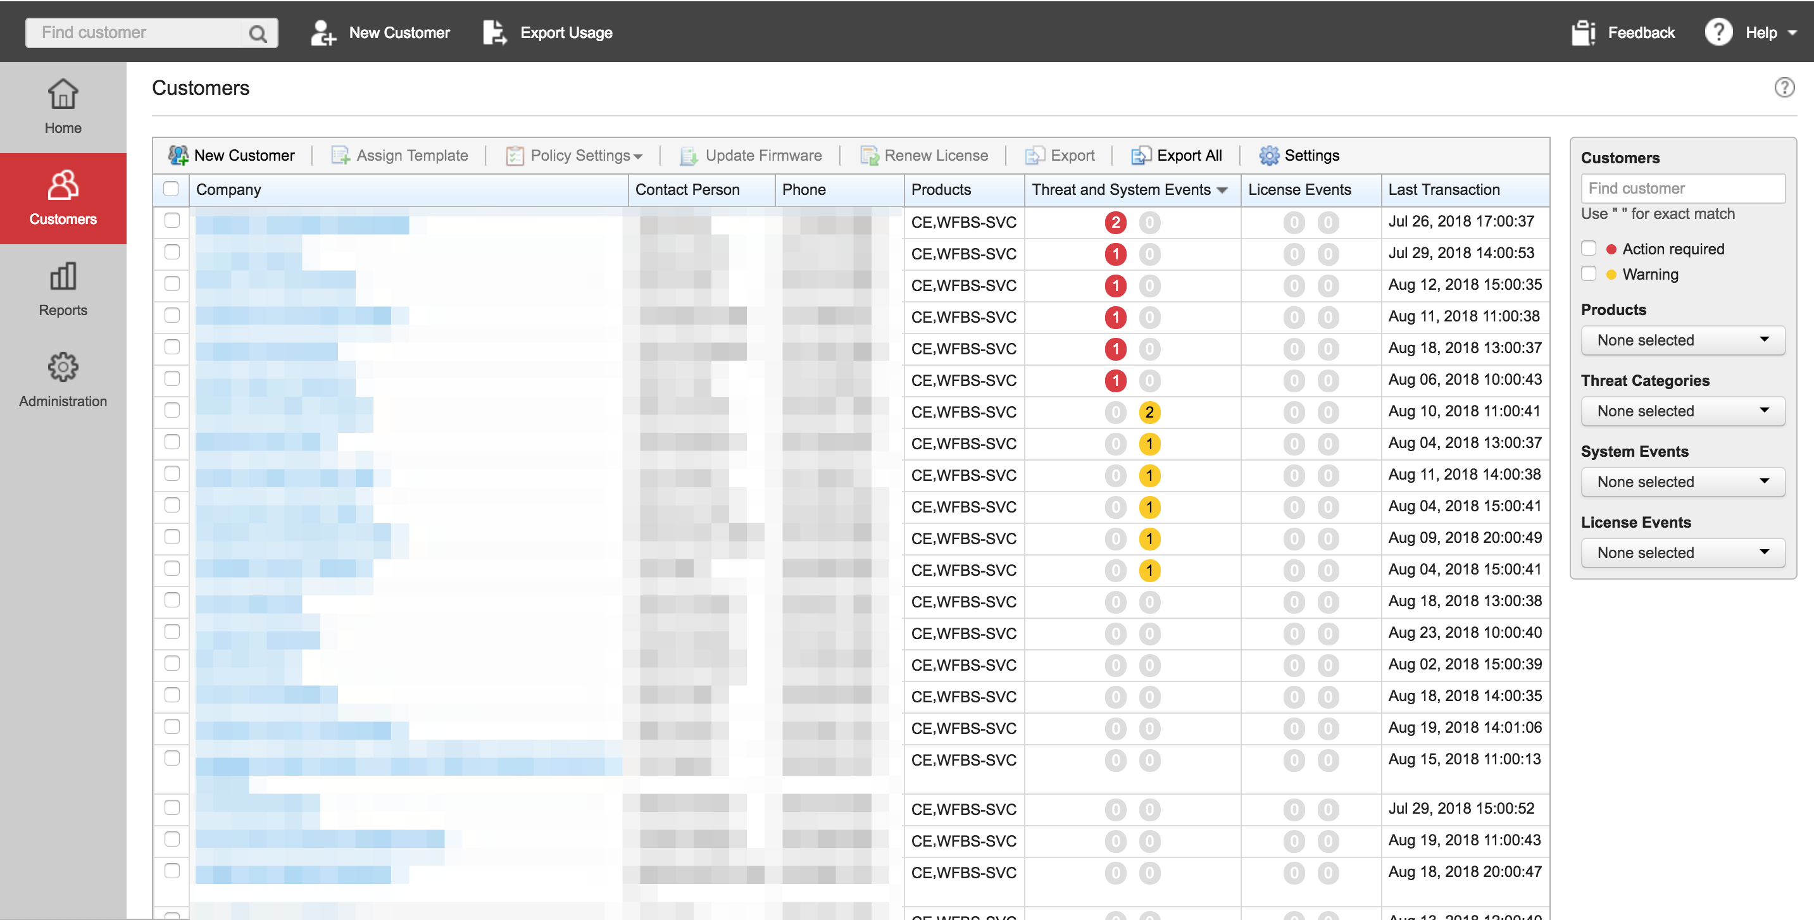
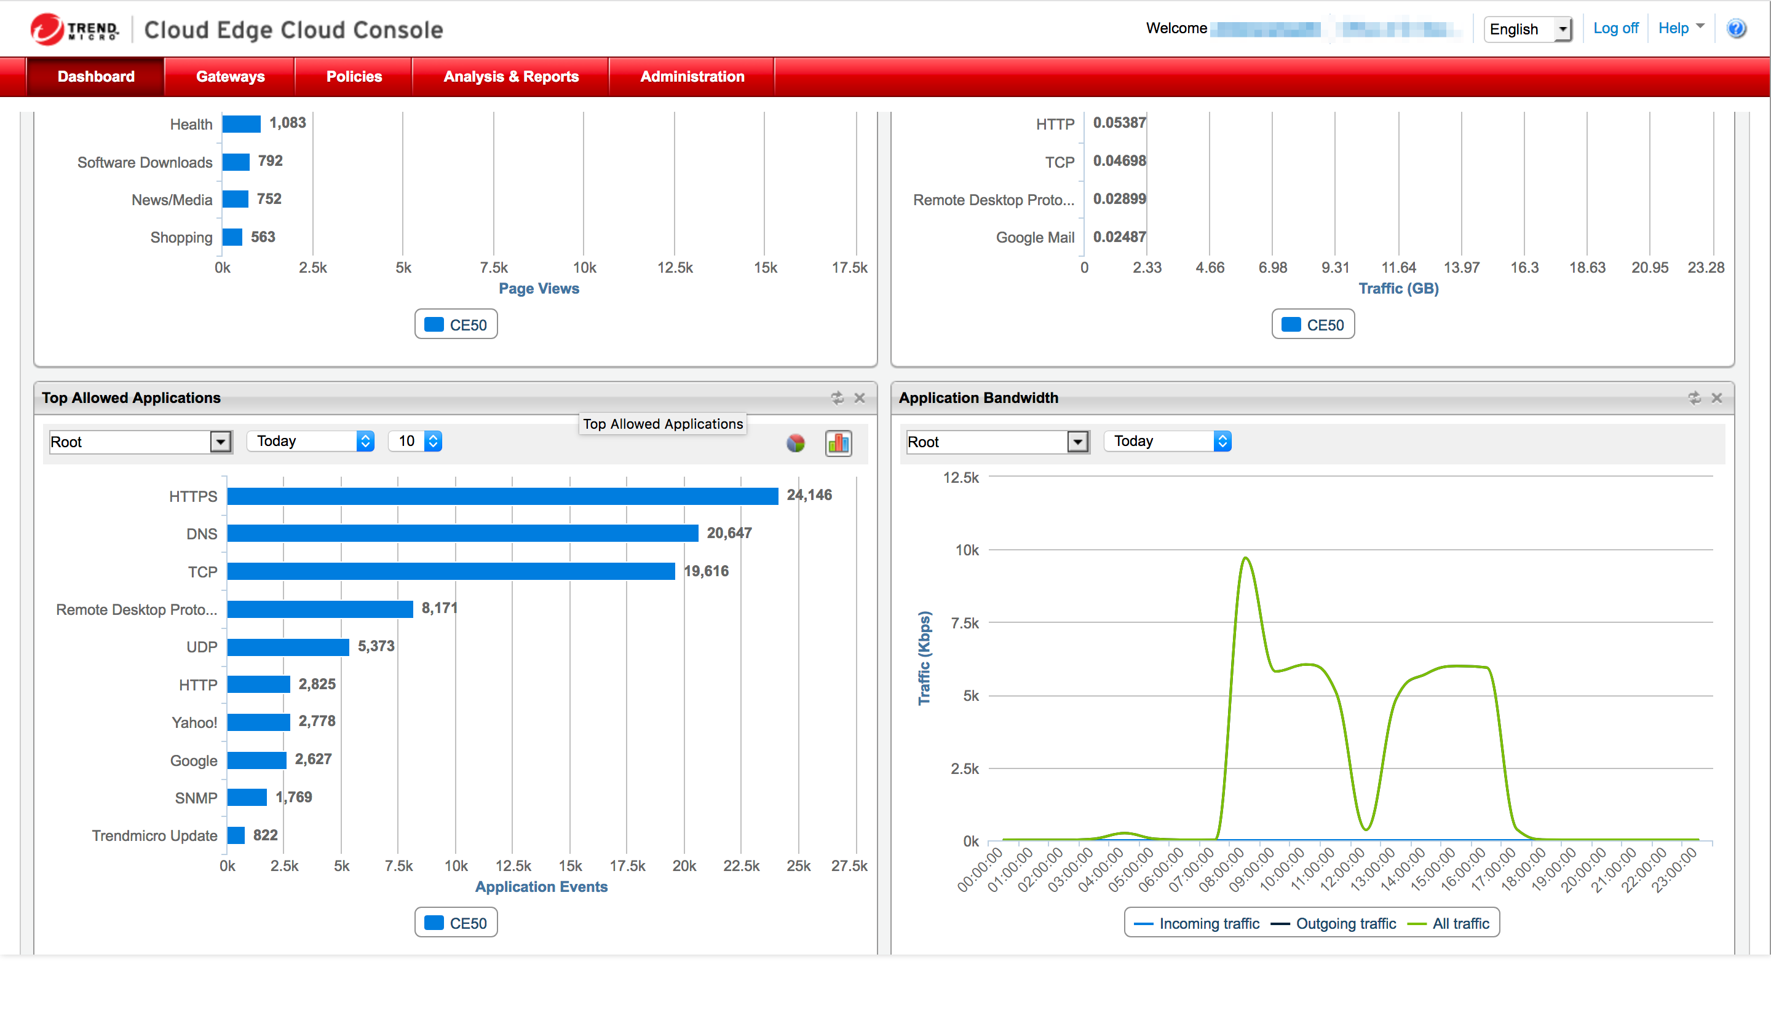
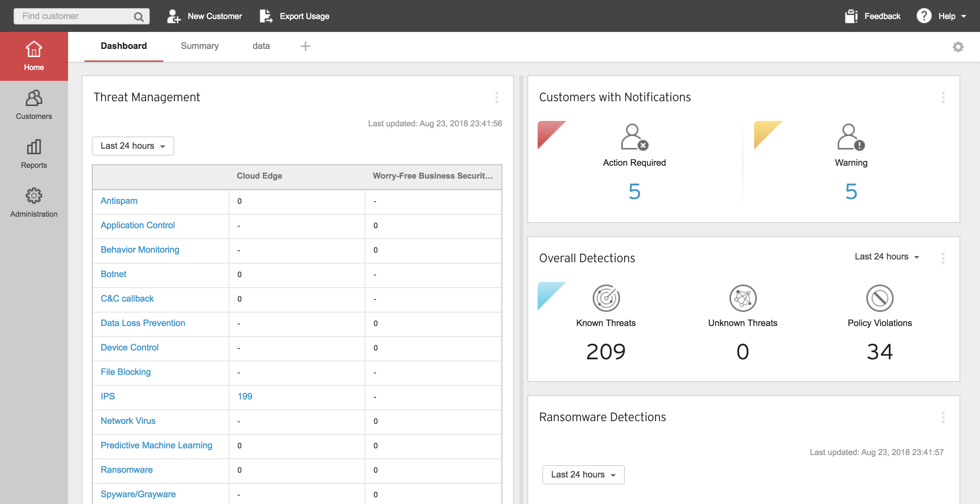
Superior Management

Slide 11
Addressing Small Business Needs
Purpose Built for MSPs
MSP Pricing Model
Integrates with existing tools
Simple Pricing Model
Better Performance
Maximum Security
Minimal User Impact
Up to 6x better throughput
Superior Management
Native SaaS
Centralized Management
Fewer Consoles
Trend Micro Research and Expertise

Slide 12
Thank You

